Slide 1
Computer Vision & AI
SW 04: Image Compression

Slide 2
Agenda
Compression
Lossless Compression
Run Length Encoding (RLE)
Lempel-Ziv Compression
Lempel-Ziv 77 (LZ77)
Lempel-Ziv 78 (LZ78)
Lempel-Ziv-Welch (LZW)
Huffman Coding
Lossy Compression Discrete Cosine Transform (DCT)
Goals
Knowledge of some Compression Methods
Application to simple Problems
Knowledge of
Advantages
Disadvantages
Applications

Slide 3
Applications
Advantages
reduction of data volume
less storage necessary
less transmission time
Fields of Application
Images
Digital Photographs (JPEG)
Videos (MPEG)
Audio (MP3)
Data
Storage
Communiction
Transmission
Reception

Slide 4
Software
RLE:
BMP (Windows Bitmap)
FAX
LZ77 GZIP, ZIP
LZ78 GIF
LZW compress
Huffman Coding pack
DCT
JPEG
MPEG

Slide 5
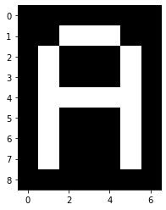
Run Length Encoding
Binary image
0, 0, 0, 0, 0, 0, 0, 0, 0, 1, 1, 1, 0, 0, 0, 1, 0, 0, 0, 1, 0, 0, 1, 0, 0, 0, 1, 0, 0, 1, 1, 1, 1, 1, 0, 0, 1, 0, 0, 0, 1, 0, 0, 1, 0, 0, 0, 1, 0, 0, 1, 0, 0, 0, 1, 0, 0, 0, 0, 0, 0, 0, 0
9 x 7 = 63 pixels
sequences of identical pixels
sequences lengths are 9, 3, 3, 1, 3, 1, 2, 1, 3, 1, 2, 5, 2, 1, 3, 1, 2, 1, 3, 1, 2, 1, 3, 1, 8
store 25 lengths instead of 63 pixel values
the longer the sequences the better the compression
worst case: checkerboard
https://en.wikipedia.org/wiki/Run-length_encoding https://de.wikipedia.org/wiki/Laufl%C3%A4ngenkodierung

Slide 6
Dictionary
Dictionary contains
some or all letters of the alphabet
as many digrams as possible
Example
String "abracadabra"
11 x 8 Bit = 88 Bit
Dictionary:
Alphabet:
0 (000): a
1 (001): b
2 (010): c
3 (011): d
4 (100): r
Digrams:
5 (101): ab
6 (110): ac
7 (111): ad
Encoding
Decomposition of string in letters and digrams: ab r ac ad ab r a
using indices instead of letters and digrams: 101 100 110 111 101 100 000
7 x 3 Bit = 21 Bit
https://en.wikipedia.org/wiki/Dictionary_coder https://de.wikipedia.org/wiki/W%C3%B6rterbuchkompression

Slide 7
LZ77: Compress (Encode)
idea: replace substrings already occured in text by codes
text to be processed next in look-ahead buffer (size 4)
text already processed in search buffer (size 6)
look for coincident substrings in lookahead and search buffer
code: (m, n, c)
index (m) and length (n) of substring in search buffer, m = n = 0: not found
last output character
Example: Compress "abracabrabra" (abra c a b ra bra)
search buffer
6 | 5 | 4 | 3 | 2 | 1
 |  |  |  |  | a
 |  |  |  | a | b
 |  |  | a | b | r
 | a | b | r | a | c
a | c | a | b | r | a
look-ahead buffer
a | b | r | a
b | r | a | c
r | a | c | a
a | c | a | b
a | b | r | a
b | r | a
code
(0, 0, a)
(0, 0, b)
(0, 0, r)
(3, 1, c)
(5, 3, a)
(3, 3, -)

Slide 8
LZ77: Decompress (Decode)
substrings in buffer: "..." character in code: '.'
no string, 'a'
no string, 'b'
no string, 'r'
"a" at index 3, 'c'
"abr" at index 5, 'a'
"bra" at index 3, no character
input
# | code
1 | (0, 0, a)
2 | (0, 0, b)
3 | (0, 0, r)
4 | (3, 1, c)
5 | (5, 3, a)
6 | (3, 3, -)
buffer
6 | 5 | 4 | 3 | 2 | 1
 |  |  |  |  | a
 |  |  |  | a | b
 |  |  | a | b | r
 | a | b | r | a | c
a | c | a | b | r | a
output
a
b
r
a | c
a | b | r | a
b | r | a
https://en.wikipedia.org/wiki/LZ77_and_LZ78#LZ77 https://de.wikipedia.org/wiki/LZ77

Slide 9
LZ78: Compress (Encode)
Example: Compress "abbcbcababcaabcaab" (a b bc bca ba bcaa bcaab)
Code: (m, c)
m: index of string in dictionary, 0 = no string
last output character
a not in dictionary, add a
b not in dictionary, add b
b in dictionary (index 2), bc not, add bc
bc in dictionary (index 3), bca not, add bca
b in dictionary (index 2), a not, add ba
bca in dictionary (index 4), bcaa not, add bcaa
bcaa in dictionary (index 6), bcaab not, add bcaab
dictionary
index | string
1 | a
2 | b
3 | bc
4 | bca
5 | ba
6 | bcaa
7 | bcaab
code
# | output
1 | (0, a)
2 | (0, b)
3 | (2, c)
4 | (3, a)
5 | (2, a)
6 | (4, a)
7 | (6, b)

Slide 10
LZ78: Decompress (Decode)
substrings from dictionary: "..." character fromcode: '.'
every output is added to the dictionary.
no string, 'a'
no string, 'b'
"b" at index 2, 'c'
"bc" at index 3, 'a'
"b" at index 2, 'a'
"bca" at index 4, 'a'
"bcaa" at index 6, 'b'
input
# | code
1 | (0, a)
2 | (0, b)
3 | (2, c)
4 | (3, a)
5 | (2, a)
6 | (4, a)
7 | (6, b)
dictionary
index | string
1 | a
2 | b
3 | bc
4 | bca
5 | ba
6 | bcaa
7 | bcaab
output
a
b
bc
bca
ba
bcaa
bcaab
https://en.wikipedia.org/wiki/LZ77_and_LZ78#LZ78 https://de.wikipedia.org/wiki/LZ78

Slide 11
LZW: Compress (Encode)
CC ← NextC
LW | CC | LW+CC | Dict | Out
- / r | r | r
r / a | a | ra | 256: ra | 114
a / b | b | ab | 257: ab | 97
b / a | a | ba | 258: ba | 98
a / r | r | ar | 259: ar | 97
r / b | b | rb | 260: rb | 114
b / ba | a | ba
ba / r | r | bar | 261: bar | 258
r / rb | b | rb
rb / a | a | rba | 262: rba | 260
a / ar | r | ar
ar / b | b | arb | 263: arb | 259
b / ba | a | ba
ba / bar | r | bar
bar / a | a | bara | 264: bara | 261
a | EOF | - | - | 97
LW + CC ∈ Dict?
yes
no
LW + CC → Dict
LW ← LW + CC
index (LW) → Out
LW ← CC
EOF?
no
yes
index (LW) → Out

Slide 12
LZW: Decompress
code ← NextCode w ← Dict [code] w → Out
while (code ← NextCode) { if (code ∈ Dict) { tmp ← w w ← Dict (code) tmp + w [0] → Dict } else { w + w [0] → Dict w ← Dict (code) } w → Out }
code | tmp | w | Dict | Out
114 |  | r |  | r
97 | r | a | 256: ra | a
98 | a | b | 257: ab | b
97 | b | a | 258: ba | a
114 | a | r | 259: ar | r
258 | r | ba | 260: rb | ba
260 | ba | rb | 261: bar | rb
259 | rb | ar | 262: rba | ar
261 | ar | bar | 263: arb | bar
97 | bar | a | 264: bara | a
https://en.wikipedia.org/wiki/Lempel%E2%80%93Ziv%E2%80%93Welch https://de.wikipedia.org/wiki/Lempel-Ziv-Welch-Algorithmus

Slide 13
Huffman Coding
count the frequencies of all characters in the text
construct a forest
with one tree for every character
every tree has
one single node: the character itself
the frequency of the character as attribute
reduce the forest to one tree
look for the two trees with the smallest frequencies
combine them as left and right subtree of a new tree
the frequency of the new tree is the sum both subtrees' frequencies
repeat the reduction until only tree is left
the result of the reduction process is the Huffman tree
for every node of the Huffman tree denote
the edge to the left subtree with 0 and
the edge to the right subtree with 1
for each character
follow the way
from the Huffman tree's root
to the character's leaf
collect the zeros and ones at the edges
to get the code of the character
https://en.wikipedia.org/wiki/Huffman_coding https://de.wikipedia.org/wiki/Huffman-Kodierung

Slide 14
Huffman Coding
Example: aeebafabacecffcdefeff, 21 Byte = 168 Bit
Frequencies: a: 4, b: 2, c: 3, d: 1, e: 5, f: 6
Huffman tree (see right)
Codes: a: 00, b: 1000, c: 101, d: 1001, e: 01, f: 11
Compressed: 00 01 01 1000 00 11 00 1000 00 101 01 101 11 11 101 1001 01 11 01 11 11 (51 Bit)
Decompressed: a e e b a f a b a c e c f f c d e f e f f f
21
1
0
12
9
0
1
6
0
1
0
1
6
3
3
4
5
0
1
2
1
a
e
b
d
c
f

Slide 15
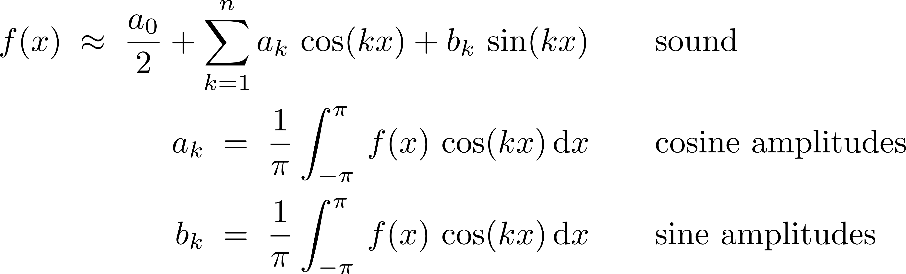
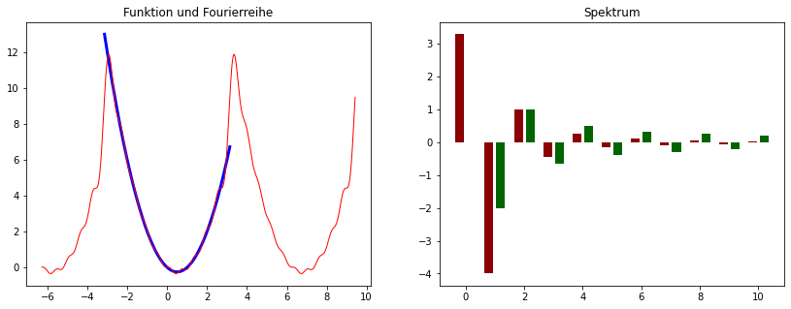
Discrete Cosine Transform
Introduction
Sound
vs noise
as a mixture of sine waves (synthesis)
Analysis:
identify all sine waves of a sound
(Fourier) analysis
Some Mathematics
https://en.wikipedia.org/wiki/Fourier_analysis https://de.wikipedia.org/wiki/Fourier-Analysis Python Notebook: fourier.ipynb

Slide 16
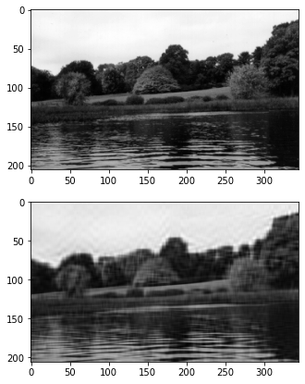
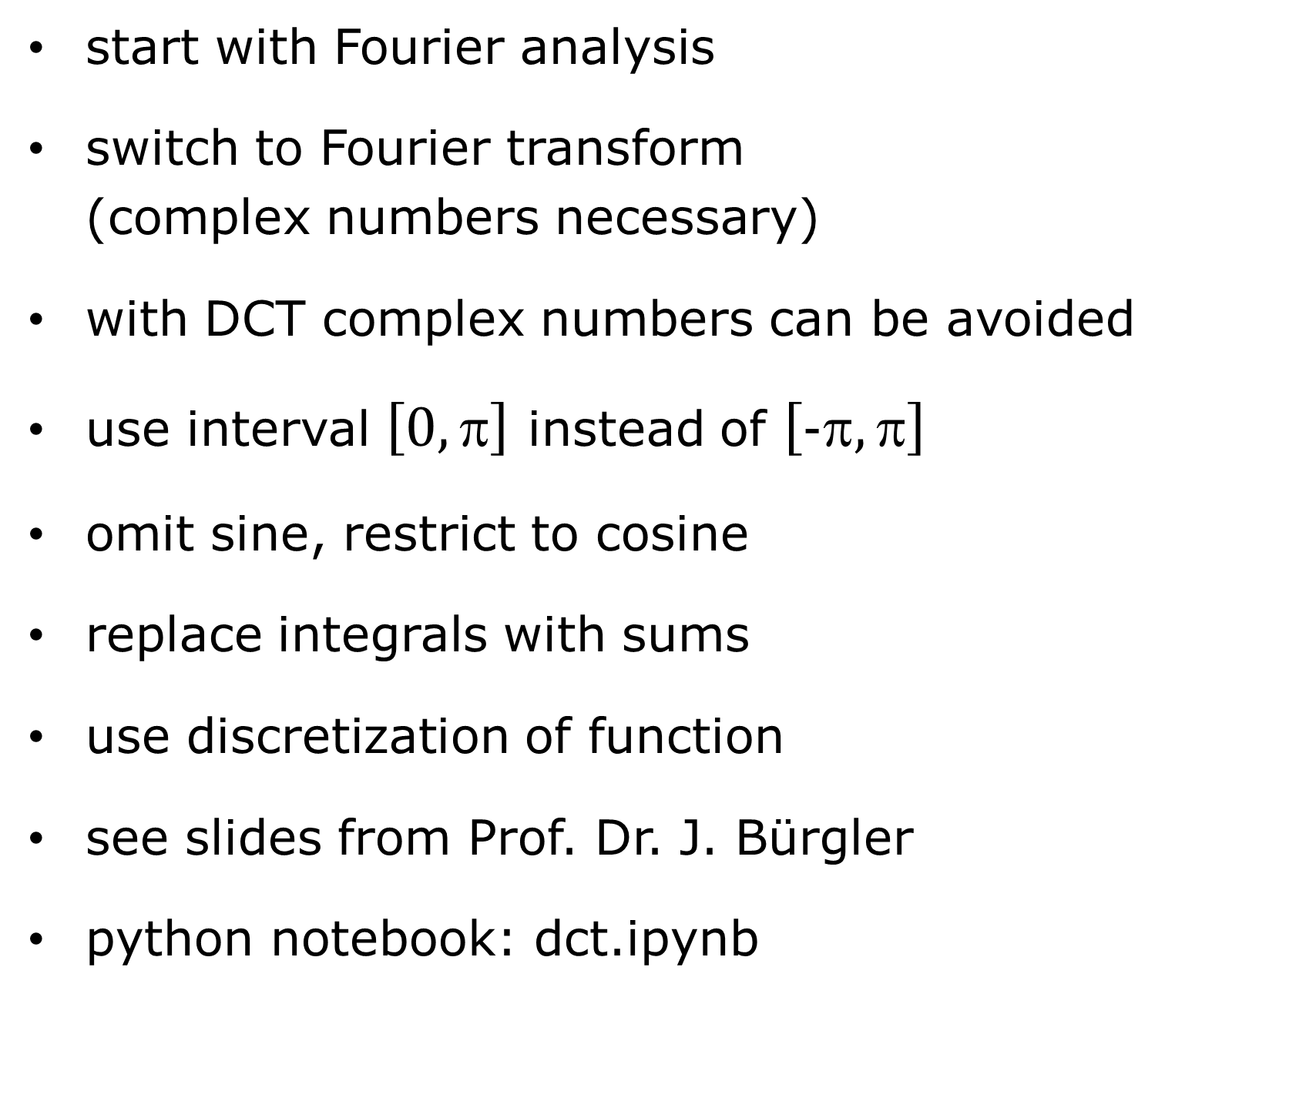
Discrete Cosine Transform
start with Fourier analysis
switch to Fourier transform (complex numbers necessary)
with DCT complex numbers can be avoided
use interval $\left[0,\text{π}\right]$ instead of $\left[\text{−}\text{π},\text{π}\right]$
omit sine, restrict to cosine
replace integrals with sums
use discretization of function
see slides from Prof. Dr. J. Bürgler
python notebook: dct.ipynb

